Slide 1
A Level Computer Science AQA 7516/1
C# Programming 3 – Iteration

Slide 2
Key Vocabulary
Iteration
Nesting
Infinite loop
Unreachable code
Count controlled
Condition controlled
Exception handling

Slide 3
Iteration
Conditional statements allow runtime decisions to be made.
Sometimes you will need to repeat code while a particular condition is true or a given number of times.
Most programming languages provide a construct for a count and condition controlled loop.

Slide 4
Count Controlled Loop - FOR
Repeats execution of a block of code a specific number of times
Uses a loop control variable
e.g. Display a row of 10 stars
for (int x = 1; x <= 10; x++)
{
Console.Write("*");
}

Slide 5
Program 3A – Two times table
Write a program to display the two times table (up to 10x2) in a single row.
Use the tab character to separate the values.
for (int x = 1; x <= 10; x++)
{
Console.Write("{0}\t", x * 2);
}

Slide 6
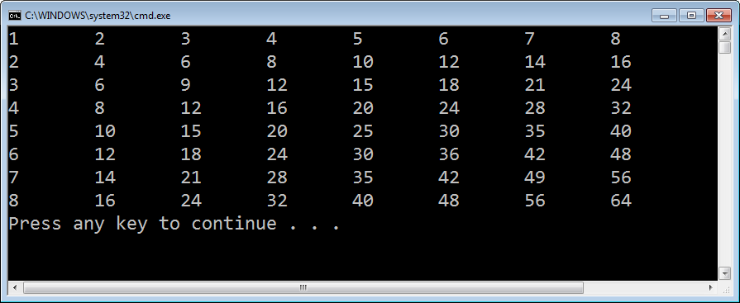
Program 3A – Multiplication Grid
Modify your program to display a 8x8 multiplication grid.
for (int y = 1; y <= 10; y++)
{
for (int x = 1; x <= 10; x++)
Console.Write("{0}\t", x * y);
Console.WriteLine();
}

Slide 7
Program 3B – Total and Average
Write a program which prompts a user to enter 5 whole numbers and then displays the total and average.
const int MAX = 5;
int Total = 0;
double Average;
Console.WriteLine("TOTAL AND AVERAGE\n");
for (int i = 0; i < MAX; i++)
{
Console.Write("Enter number {0}: ", i + 1);
Total += int.Parse(Console.ReadLine());
}
Average = Total / (double)MAX;
Console.WriteLine("Total = {0}\nAverage = {1}", Total, Average.ToString("0.0"));

Slide 8
Array processing
Count controlled loops are very convenient for accessing array elements.
int[] Numbers = new int[10];
for (int i = 0; i < 10; i++)
{
Console.Write("Enter number {0}: ", i + 1);
Numbers[i] = int.Parse(Console.ReadLine());
}

Slide 9
Condition Controlled Loop - WHILE
Repeats execution of a block of code while condition is true
while (condition)
{…}
Evaluates test condition before first iteration
So might never execute loop.
do
{…} while (condition);
Evaluates test condition after first iteration
So executes loop at least once.

Slide 10
Unreachable Code
If we test the condition at the beginning of the loop construct, we may never pass through the code.
So unreachable code could be a problem.
while (1 + 1 == 1)
{
Console.WriteLine("Contradication");
}

Slide 11

Infinite Loop
A program hangs when caught in an infinite loop.
Caused by condition controlled loops which have no way of affecting the outcome of the test condition.
while (1 + 1 == 2)
{
Console.WriteLine("Tautology");
}

Slide 12
Program 3C – Let me in
Write a program that prompts a user to enter a predetermined password and either grants or denies access. Up to 3 attempts should be allowed (user should be advised how many attempts remain with each prompt).
const string PASSWORD = "please";
const int MAX_ATTEMPTS = 3;
int Attempts = 0;
string Value;
do
{
Console.Write("What's the magic word? ({0} attempts remaining): ",
MAX_ATTEMPTS - Attempts);
Attempts++;
Value = Console.ReadLine();
} while (Value != PASSWORD && Attempts < MAX);
if (Value == PASSWORD)
Console.WriteLine("Access granted.");
else
Console.WriteLine("Access denied.");

Slide 13
Program 3D – Factorial
Write a program to calculate and display the factorial of a number entered by the user.
Decide upon the most appropriate iterative construct – FOR or WHILE.
int Factorial = 1;
int n, Counter;
Console.WriteLine("FACTORIAL CALCULATOR\n");
Console.Write("Enter a whole number: ");
n = int.Parse(Console.ReadLine());
Counter = n;
while (Counter > 1)
{
Factorial *= Counter;
Counter--;
}
Console.WriteLine("{0}! = {1}", n, Factorial);

Slide 14
Program 3D – Factorial
Write a program to calculate and display the factorial of a number entered by the user.
Decide upon the most appropriate iterative construct – FOR or WHILE.
int Factorial = 1;
int n, Counter;
Console.WriteLine("FACTORIAL CALCULATOR\n");
Console.Write("Enter a whole number: ");
n = int.Parse(Console.ReadLine());
for (Counter = 1; Counter <= n; Counter++)
{
Factorial *= Counter;
}
Console.WriteLine("{0}! = {1}", n, Factorial);

Slide 15
Exception Handling
Syntax (compilation errors) are a breeze to address, especially with a great IDE like Visual Studio.
Once compiled though, a run-time error (crash) can spoil all the fun.
Programs should never crash. It is simply poor coding!
An exception will be thrown if a conversion is attempted that leads to a data type mismatch.
Exceptions can be handled to prevent run-time errors, using the Try...Catch construct in C#.

Slide 16
Try…Catch
int Number = 0;
int Square = 0;
bool BadType = false;
Console.WriteLine("SQUARE NUMBER PROGRAM\n");
Console.Write("Enter a whole number: ");
try
{
Number = int.Parse(Console.ReadLine());
}
catch
{
BadType = true;
}
if (BadType)
Console.WriteLine("Invalid type entered");
else
{
Square = (int)Math.Pow(Number,2);
Console.WriteLine("{0}\xB2 = {1}", Number, Square);
}
It is best practise not to jam-pack the try block.
The only line that could throw an exception is the call to int.Parse

Slide 17
Assessment 1 - Better Validation
Modify your solution to Assessment 1 (double glazing calculator) so that the width and height are validated as follows:
Width must be between 0.5 and 5.0
Height must be between 0.75 and 3.0
If a value is entered which is an invalid type or invalid range, an appropriate error message should be reported and the prompt should be repeated; the user should be continually prompted until a valid entry is made.
Hint: Enclosing a Try…Catch statement inside a condition controlled loop is particularly useful in ensuring valid input.

Slide 18
Using Files
All data stored in our programs so far has been stored in RAM.
In order to keep data beyond the running time of the program we need to use files.
Reading and writing text files is as easy as reading from and writing to the console!

Slide 19
Reading Text Files
A stream is a link between your program and a file (actually it is a link to the OS which handles the file directly).
using System.IO;
const string FILEPATH = @"H:\MyFile.txt";
…
StreamReader rFile;
string FirstLine;
rFile = new StreamReader(FILEPATH);
FirstLine = rFile.ReadLine();
rFile.Close();
Console.WriteLine(FirstLine);

Slide 20
Try…Catch
The filename, path and format are beyond the control of the program, and so exception handling should be used.
StreamReader rFile;
string FirstLine = "";
bool FileOK = true;
try
{
rFile = new StreamReader(FILENAME);
FirstLine = rFile.ReadLine();
rFile.Close();
}
catch
{
FileOK = false;
}
if (FileOK)
Console.Write(FirstLine);
else
Console.WriteLine("File could not be opened.");

Slide 21
Writing Text Files
Data can flow upstream or downstream.
When we open an upstream connection (file writing), we need to specify a mode – append to the end or create to overwrite the file contents.
using System.IO;
const string FILENAME = @"H:\MyFile.txt";
StreamWriter wFile;
string FirstLine = "Hello world!";
wFile = new StreamWriter(File.Open(FILENAME, FileMode.Create));
wFile.WriteLine(FirstLine);
wFile.Close();
Beware - any file opened for overwriting will instantly be wiped!
A clean file close is essential, or data will not be readable.

Slide 22
Reading multiple lines
Of course, if we had an unknown number of lines in a text file, we would need to read until the end of file marker (EOF) is read.
A property indicating whether the EOF has been reached is built into the StreamReader class, called EndOfStream. It returns a Boolean type.
Notes:
A method of StreamReader called ReadToEnd will read an entire text file in a single go into one string variable – but we want to practise reading one line a time using a while loop.

Slide 23
Program 3E
Build a program that displays the complete contents of a text file, the full path of which is entered at runtime.
If the file cannot be opened, the program should say so and then terminate.
string Filename;
StreamReader rFile;
string Contents = "";
bool FileOK = true;
Console.Write("Please enter full file path (including drive and extension): ");
Filename = Console.ReadLine();
try
{
rFile = new StreamReader(Filename);
while (!rFile.EndOfStream)
Contents = string.Concat(Contents, rFile.ReadLine(), "\n");
rFile.Close();
}
catch
{
FileOK = false;
}
if (FileOK)
Console.WriteLine(Contents);
else
Console.WriteLine("File could not be opened.");

